Slide 1
Depth First Traversal - The Maze
Submitted by Manish Bafna
Student Id: 19655
Instructor: Dr. Henry Chang
GIT: End-to-End Machine Learning Project

Slide 2
Table of Content
Introduction
Design
Implementation
Test
Enhancement Ideas
Conclusion
References

Slide 3
Introduction
Depth-First Traversal (DFS) Concept:
DFS is a graph traversal algorithm that explores as far as possible along each branch before backtracking.
It starts from a selected node (or starting point) and visits all reachable nodes as deeply as possible along each branch before backtracking.
DFS uses a stack (or recursion) to keep track of nodes to be visited.
At each step, it pops a node from the stack, marks it as visited, and then explores its adjacent unvisited nodes.
The process continues until all reachable nodes have been visited.

Slide 4
Introduction
Application of DFS to Mazes:
In a maze represented as a graph, each cell is a node, and adjacent cells connected by passages are connected by edges.
DFS can be applied to navigate through the maze to find a path from the start position to the destination.
The algorithm starts at the start position, explores one possible direction as far as possible, and backtracks if it reaches a dead-end or the destination.
It continues this process until it reaches the destination or exhausts all possible paths.
DFS is well-suited for solving mazes because it explores one path as deeply as possible before trying alternative paths.

Slide 5
Introduction
Application of DFS to Trees:
In the context of trees, DFS can be used to traverse the tree nodes in a depth-first manner.
There are two common DFS strategies for trees: Pre-order DFS and In-order DFS.
Pre-order DFS: Visit the current node, then recursively visit the left subtree, and finally, recursively visit the right subtree.
In-order DFS: Recursively visit the left subtree, then visit the current node, and finally, recursively visit the right subtree.
DFS is useful in scenarios where we need to explore the tree in a specific order, such as printing nodes in a particular sequence or searching for specific elements.

Slide 6
Overview
The problem statement is to determine if a ball can reach the destination in a maze. The maze is represented as a 2D matrix of size MxN, where each cell is either a 0 (empty space) or a 1 (wall). The ball can move up, down, left, or right, but it can't go through walls. The ball starts at a given starting position, and the destination is another cell in the matrix. We need to find if the ball can reach the destination by navigating through the maze.

Slide 7
Design
We use Depth First Search algorithm for this problem statement
There are two approaches
Approach 1: Convert Maze to Graph/tree and Apply DFS using Stack:
Convert the maze into a tree-like structure, where each node represents a cell in the maze, and edges indicate valid movements between cells (no wall).
Start from the starting position and create a node for it in the tree.
Create a stack and push the node for the starting position onto it.

Slide 8
Design
While the stack is not empty, do the following:
Pop the top node from the stack.
Mark the current node as visited to avoid revisiting it.
For the current node, explore all its neighbors (nodes representing valid movements from the current position).
If any neighbor node represents the destination, return true as the destination is reachable.
If a neighbor node is not visited, mark it as visited and push it onto the stack.
If the stack becomes empty and the destination is not reached, return false.

Slide 9
Design
Approach 2: Matrix Approach:
Start from the starting position in the matrix.
Mark the current position as visited to avoid revisiting it.
For the current position, try moving the ball in all four possible directions (up, down, left, right).
Check if the new position after moving is valid (not a wall and within the matrix boundaries).
If the new position is valid, recursively call DFS on the new position.
If DFS returns true (i.e., the destination is reached), return true.
If none of the directions lead to the destination, return false.

Slide 10
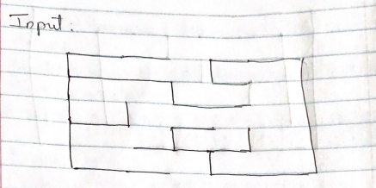
Design-Manual Solution using Approach 1
Depth First Traversal on a Maze
Ans: We will first convert the input Maze to a graph and then use the DFT to get the solution
Step 1: Converting input maze to graph

Slide 11
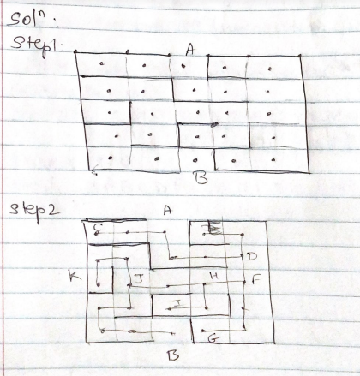
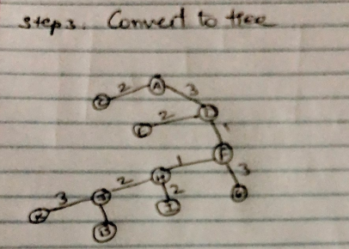
Design-Manual Solution

Slide 12
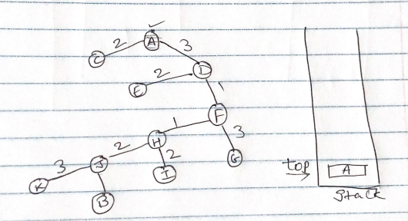
Design-Manual Solution
Step 2: Depth First Traversal on the graph using stack
Initialize the stack
Since A is the starting node, we mark A as visited and put it into stack. Explore any unvisited adjacent node from A. We have 2 unvisited nodes from A. we pick up the next node based on alphabetical order which in this case is C

Slide 13
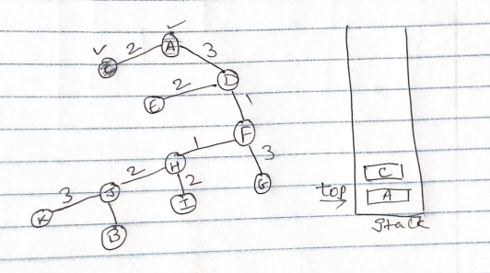
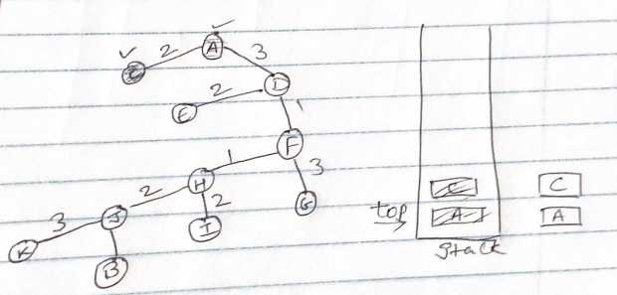
Design-Manual Solution
Mark C as visited and put it into stack. Explore any unvisited adjacent node from C. We have 0 nodes from C.
Since there is no unvisited node from C, we pop out all the nodes from the stack one each at a time and then start over from A

Slide 14
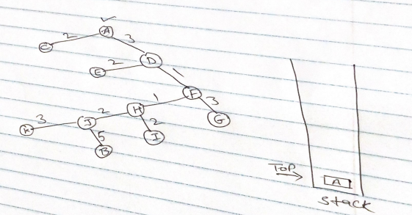
Design-Manual Solution
Re-Initialize the stack
Since A is the starting node, we mark A as visited and put it into stack. Explore any unvisited adjacent node from A. We have 1 unvisited nodes from A. we pick up the next node which in this case is D

Slide 15
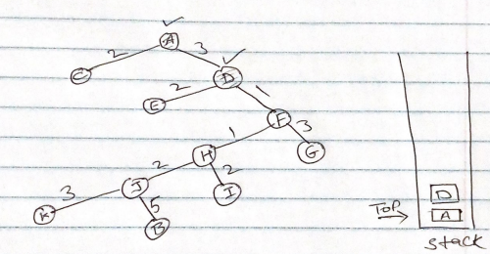
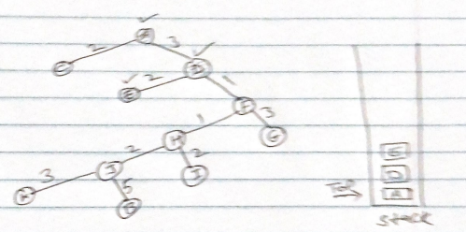
Design-Manual Solution
Mark D as visited and put it into stack. Explore any unvisited adjacent node from D. We have 2 nodes from D. we pick up the next node based on alphabetical order which in this case is E
Mark E as visited and put it into stack. Explore any unvisited adjacent node from E. We have 0 nodes from E.

Slide 16
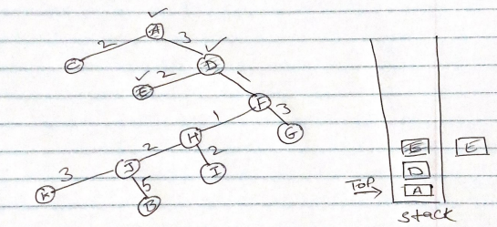
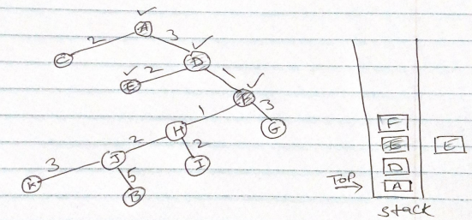
Design-Manual Solution
Since there is no unvisited node from E, we pop out E and then start over from D
Since D is already visited and in stack, we Explore any unvisited adjacent node from D. We have 1 unvisited nodes from D. we pick up the next node which in this case is F,
Mark F as visited and put it into stack. Explore any unvisited adjacent node from F. We have 2 nodes from F. we pick up the next node based on alphabetical order which in this case is G

Slide 17
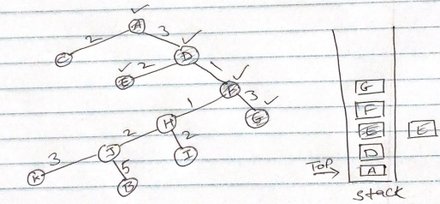
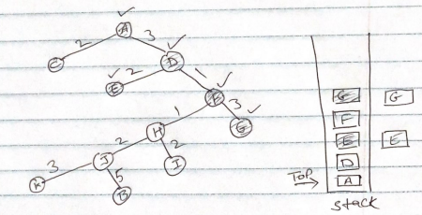
Design-Manual Solution
Mark G as visited and put it into stack. Explore any unvisited adjacent node from G. We have 0 nodes from G.
Since there is no unvisited node from G, we pop out G and then start over from F

Slide 18
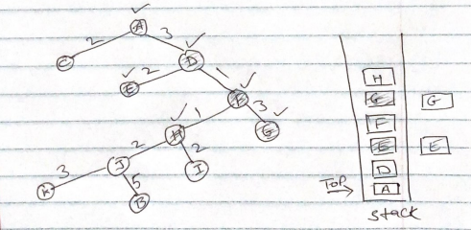
Design-Manual Solution
Since F is already visited and in stack, we Explore any unvisited adjacent node from F. We have 1 unvisited nodes from F. we pick up the next node which in this case is H,
Mark H as visited and put it into stack. Explore any unvisited adjacent node from H. We have 2 nodes from H. we pick up the next node based on alphabetical order which in this case is I

Slide 19
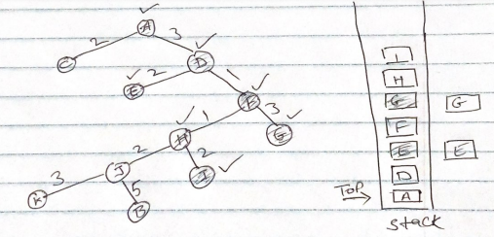
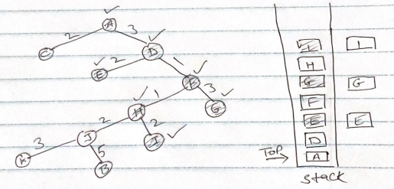
Design-Manual Solution
Mark I as visited and put it into stack. Explore any unvisited adjacent node from I. We have 0 nodes from I.
Since there is no unvisited node from I, we pop out I and then start over from H

Slide 20
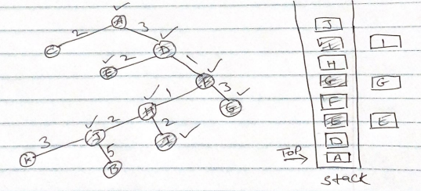
Design-Manual Solution
Since H is already visited and in stack, we Explore any unvisited adjacent node from H. We have 1 unvisited nodes from H. we pick up the next node which in this case is J,
Mark J as visited and put it into stack. Explore any unvisited adjacent node from J. We have 2 nodes from J. we pick up the next node based on alphabetical order which in this case is B

Slide 21
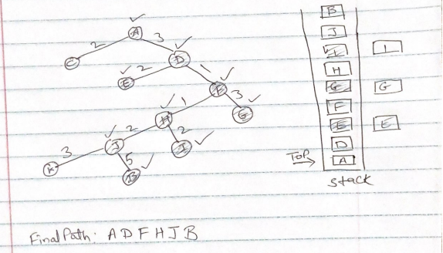
Design-Manual Solution
Mark B as visited and put it into stack. Since B is the destination node and no more nodes that are unvisited from B, we stop the process here
Final Output: A D F H J B

Slide 22
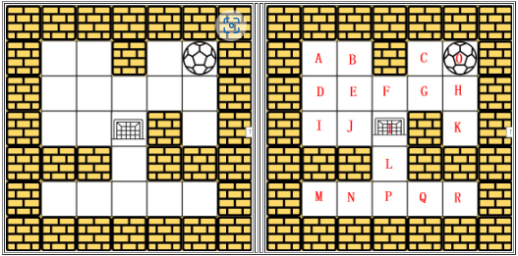
Design-Manual Solution Approach 2
Matrix Approach:
Input:
Search pattern: Right, Left, Top, Bottom

Slide 23
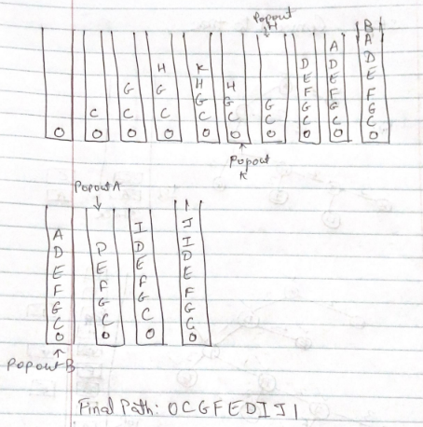
Design-Manual Solution Approach 2
Soln:
We use Stack to showcase our understanding. The ball can move only one cell at a time
Final Output: 0 C G F E D I J 1

Slide 24
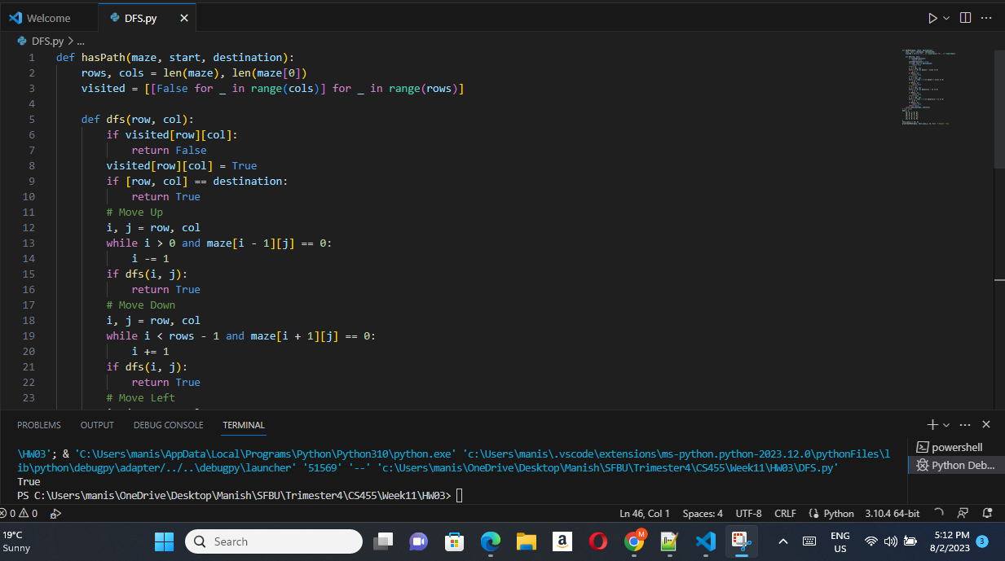
Implementation

Slide 25
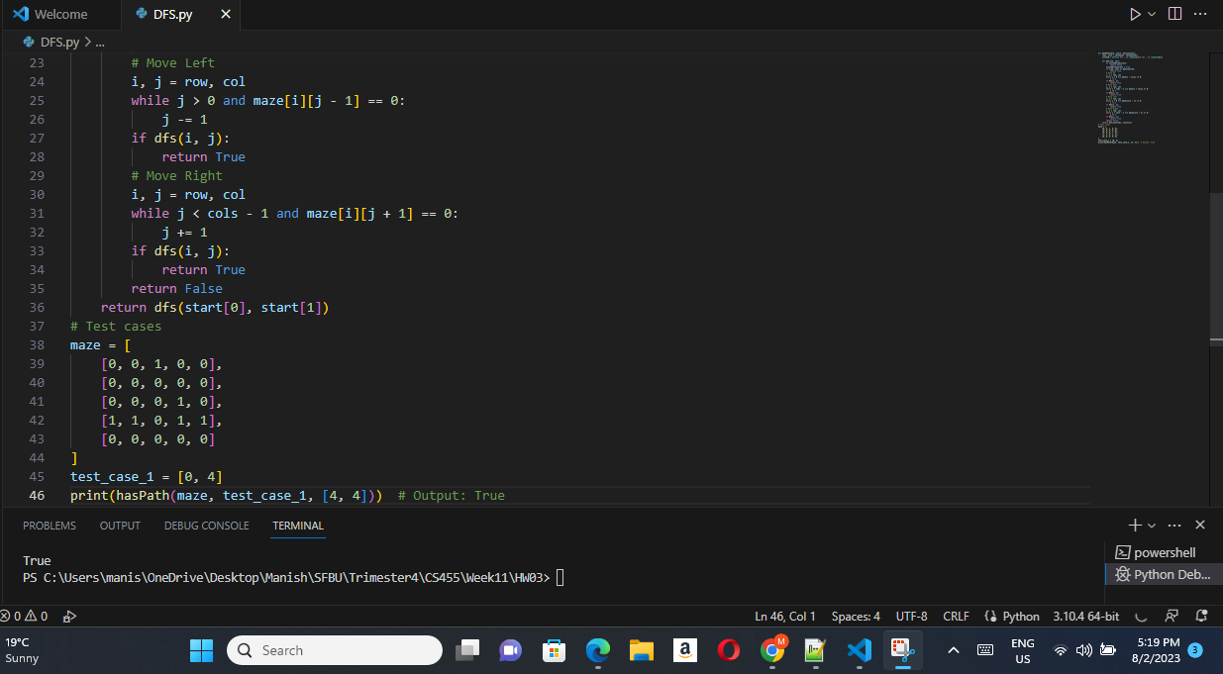
Implementation

Slide 26
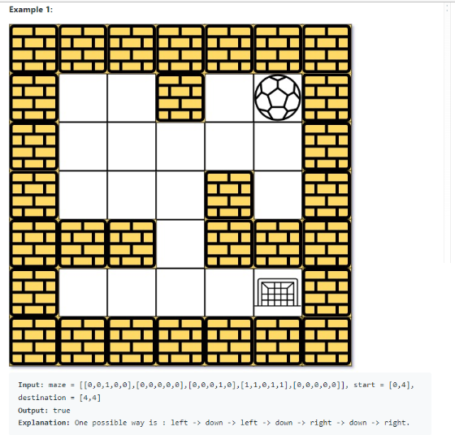
Test
Test Case 1:

Slide 27
Test
Test Case 1: Solution:

Slide 28
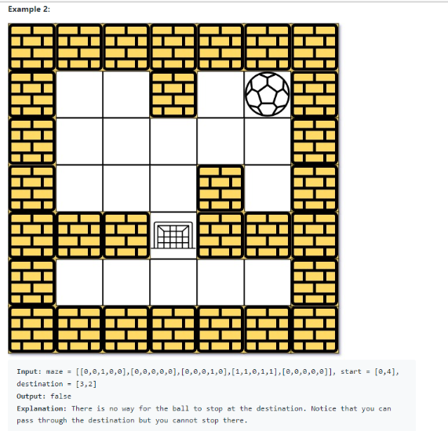
Test
Test Case 2:

Slide 29
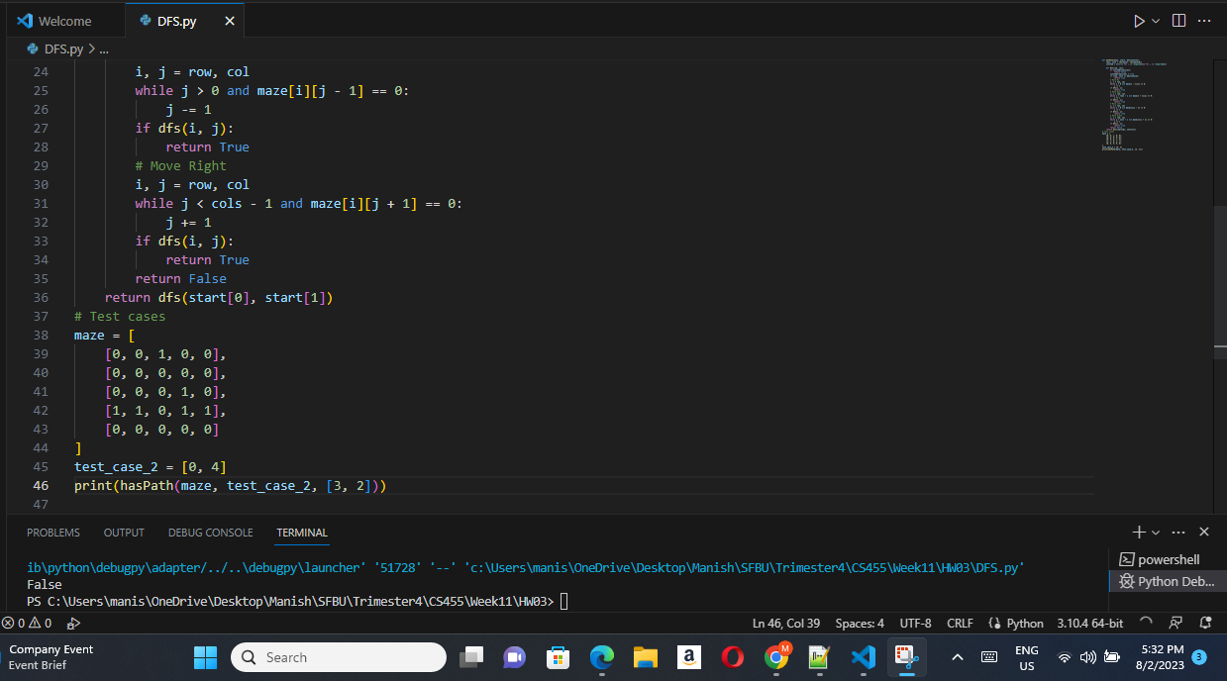
Test
Test Case 2: Solution:

Slide 30
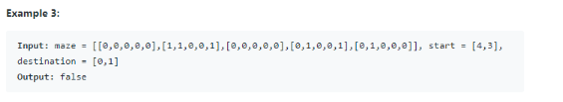
Test
Test Case 3:

Slide 31

Test
Test Case 3: Solution:

Slide 32
Enhancement Ideas
Depth-First Search with Memoization:
Implement DFS with memoization to avoid revisiting previously explored cells.
Store the results of previously visited cells to skip redundant computations.
Reduces time complexity, especially for larger mazes.
Breadth-First Search (BFS) Alternative:
Implement the maze-solving algorithm using BFS instead of DFS.
BFS explores the maze level by level and may be more efficient in some scenarios.
Compare the performance of DFS and BFS for the given maze characteristics.

Slide 33
Enhancement Ideas
Multiple Destinations:
Modify the problem to handle multiple destination positions in the maze.
Find paths to various target points from a common starting position.
Useful when paths to multiple destinations are required.
Dynamic Programming:
Explore dynamic programming approaches to solve the maze efficiently.
Break down the maze into smaller subproblems and store results for optimization.
Avoid redundant computations and speed up the solving process.
Heuristic Search:
Use heuristic search algorithms like A* (A-star) for the shortest path finding.
Estimate the distance to the goal for faster and more optimal solutions.

Slide 34
Conclusion
LeetCode question 490, "The Maze," involves solving a maze using depth-first traversal.
Implement DFS and follow movement rules to efficiently explore paths from start to destination.
Enhance the algorithm's performance with ideas like DFS with memoization and BFS alternative.
Consider handling multiple destinations and employing dynamic programming techniques.
Heuristic search algorithms like A* can lead to faster and more optimal solutions.
The choice of enhancements depends on the maze characteristics and optimization requirements.

Slide 35
References
Exercises for Elementary Graph Algorithms (sfbu.edu)
Depth First Traversal (sfbu.edu)
Legged Robots Learn to Hike Harsh Terrain - IEEE Spectrum
Exercises for Elementary Graph Algorithms (sfbu.edu)
Maze (sfbu.edu)

